Slide 1




INNOVATION PRACTICES
Asset Tracking System - Inventory management

Slide 2





Table of Content
Our Team Our Mentors
Problem Statement Abstract Literature Survey
Hardware and Software requirements System analysis and design References
Timeline Chart

Slide 3




K Sandeep Kumar
19Z323
Surtik S
19Z351
Our Team
Mahesh Boopathy
19Z330
Venkata Gowtham
19Z360
Ajith Narayana
19Z331
Rithish B
20Z464

Slide 4



Dr. Kavitha C
PSG College of Technology
Gowripriya Kulasekar
Verticurl
Our Mentors
Leslie George
Verticurl
Mohanraj Ramamurthy
Verticurl
Naveen N
Verticurl

Slide 5


Problem Statement
To design an Asset Tracking system that :
Handle from asset inward to disposal.
Should be able to group the assets and also capture the consumables inwards.
The assets to be tagged based on barcodes and in the system.
System Notification to users & admin accordingly.
Analytical reports such as depreciation reports.

Slide 6

Abstract
The project is to develop an asset tracking system that can handle everything from receiving assets to disposing of various consumables. The system represents a systematic process for maintaining, upgrading, and operating physical assets in a cost-effective manner with a focus on potential interactions within the universal system. Assets are grouped together and marked with a barcode, which allows the allocators to assign them to the employees when they are needed. When the assets or consumables have depreciated beyond the set threshold, or when the available stock falls below the set value, the system alerts the administrator, allowing them to place an order for more stock of that particular asset or consumable. The warranties for the various items vary, and users should be notified when the warranty period is about to expire or when a planned repair appointment is due. The administrator can also generate reports that compare the number of assets, consumables, and scrap to the overall number of assets. These reports also provide a variety of graphical representations to aid with reading and comprehension.

Slide 7




Literature Survey
Asset Management: A Systems Perspective
Vhance V. Valencia, John M. Colombi, Alfred E. Thal, Jr., and William E. Sitzabee
PAPER DESCRIPTION
The goal of this study is to compare and contrast best practices in systems engineering and infrastructure management.This paper aims to show that the ISO 15288 processes, as described In 2010 INCOSE, can be applied to the engineering management of infrastructure. This paper also shows why a life cycle based approach is needed and shows how six of the many process stages in the life cycle can be tailored to fit the asset management model for infrastructure oriented ventures.

Slide 8
Literature Survey
Study of Smart Inventory management system based on Internet Of Things (IOT)
Souvik Paul*, Atrayee Chatterjee; Digbijay Guha
PAPER DESCRIPTION
This paper describes the principles and structure of a new type of intelligent Inventory Management System based on the Internet of Things. This method has a lot of advantages over the traditional modes like bar code scanners where human intervention is needed thus reducing human errors.An IoT-based inventory management and asset tracking solution offers constant visibility into the inventory by providing real-time information fetched by RFID tags. It helps to track the precise location of raw materials, work-in-progress and finished goods. As a result, manufacturers can balance the amount of on-hand inventory, increase the utilization of machines, reduce lead time, and thus, avoid hidden costs bound to the less effective manual methods.

Slide 9




Literature Survey
Asset Management System Analysis
Goran Kolevski, Marjan Gusev
PAPER DESCRIPTION
The purpose of this article is to demonstrate the relevance of an asset management strategy, highlight the critical function of an asset management system, and identify the desirable features. Another essential part of the paper is that it demonstrates that the Software as a Service (SaaS) business model is the greatest fit for small and medium businesses. The purpose of this study is to establish a framework for evaluating asset management systems. Some of the already available solutions are being compared and assessed against it. In general, several of the systems scored well in some of the categories, excelling in some of the factors, but were not successful in other metrics.

Slide 10


Literature Survey
Django Documentation
DESCRIPTION
Django is a high-level Python web framework that encourages rapid development and clean, pragmatic design. Django was designed to help developers take applications from concept to completion as quickly as possible. Django takes security seriously and helps developers avoid many common security mistakes. Some of the busiest sites on the web leverage Django’s ability to quickly and flexibly scale.

Slide 11



Literature Survey
Bootstrap Documentation
DESCRIPTION
Helps design and customize responsive webpages using responsive grid systems, extensive prebuilt components, and JavaScript. It includes HTML and CSS-based design templates for typography, forms, buttons, tables, navigation, modals, image carousels, and many others. It can also use JavaScript plug-ins.

Slide 12
Hardware and Software
Requirements
Hardware Requirements
Web-Cam or Phone Camera
QR Printer Memory
Minimum 2 GB Ram
Processor
1.9 gigahertz (GHz) x86- or x64-bit dual-core processor with SSE2 instruction set
Software Requirements
Operating System Windows 7 or Above
PyCharm
Backend Framework Django (Python)
Frontend
HTML, CSS
JS, jQuery Bootstrap 5
Database
MongoDB

Slide 13
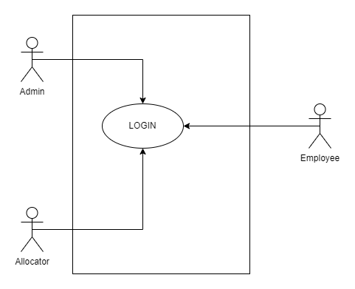

System Analysis and Design

Slide 14
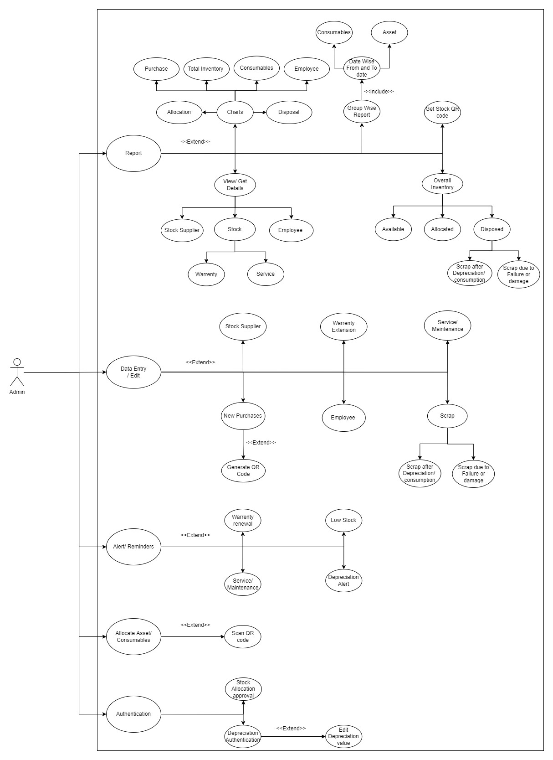

System Analysis and Design

Slide 15
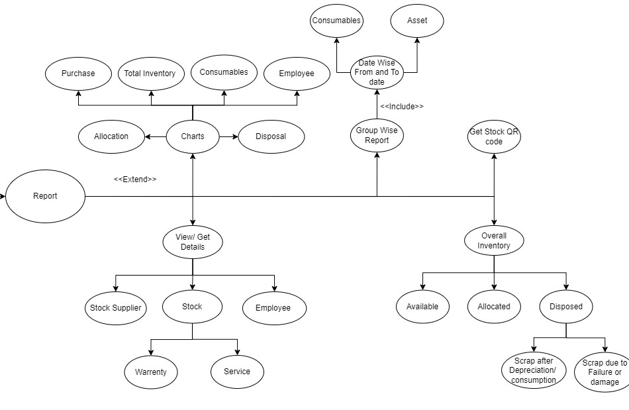

System Analysis and Design

Slide 16
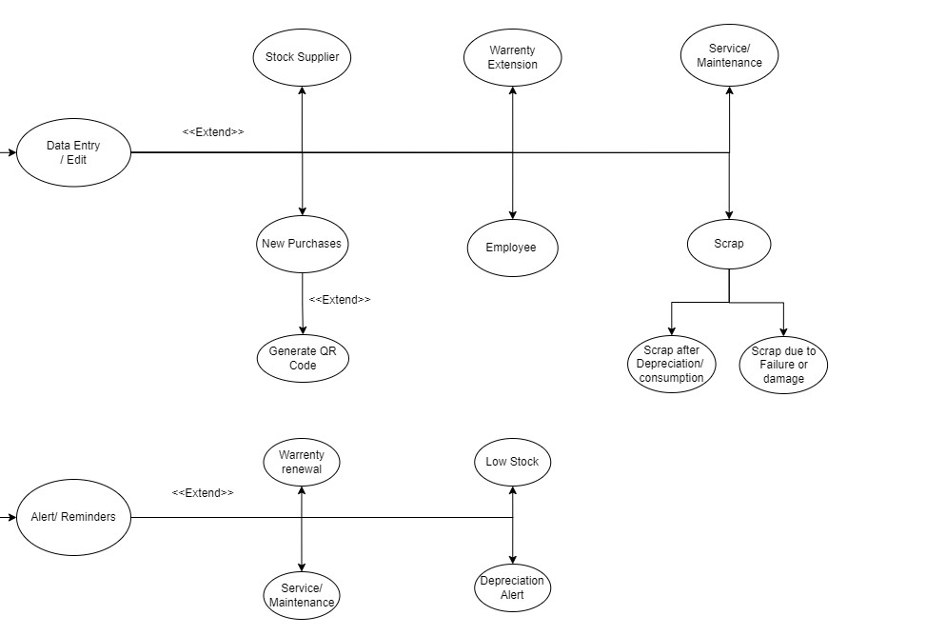

System Analysis and Design

Slide 17
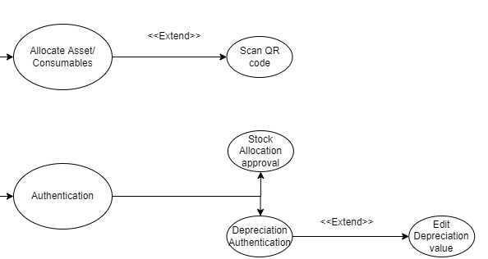

System Analysis and Design

Slide 18
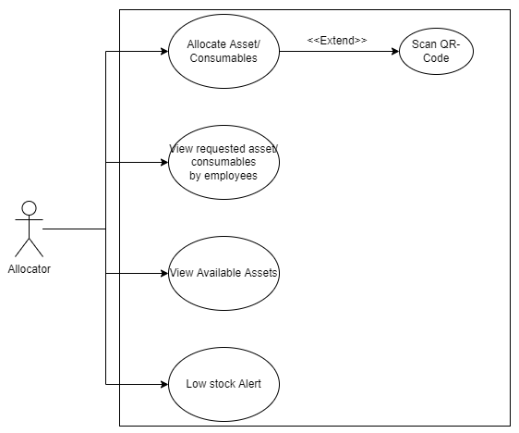
System Analysis and Design

Slide 19
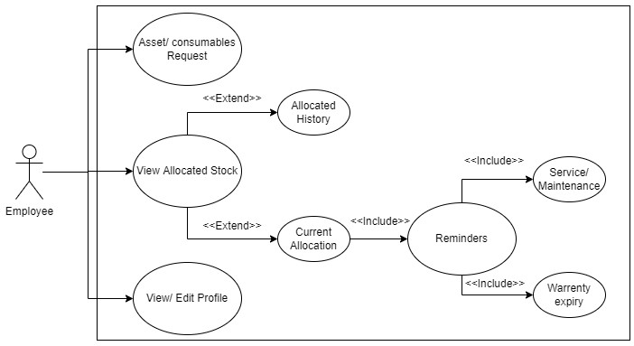
System Analysis and Design

Slide 20



Timeline
6
5
4
Worked on the stock, employee, and supplier views on the admin page, as well as the QR scanning and QR creation sections of the project.
3
2
Dashboards, data
Performed the System Setup and started the project from the admin portal
entry, and edit parts of the
1
worked on the Usecase Diagram and the Project Flow.
project's Admin
Studied research papers that were apropos to our problem statement
page were worked on.
Understanding the Problem Statement Worked on the design thinking process

Slide 21


Timeline
12
11
10
9
FINAL DEPLOYMENT OF THE WEBSITE
8
Testing the website
Connecting the MongoDB and SMTP to the django Framework
with possible
7
Completing the Employee section of the project and connecting it with the django framework
testcases and bug
fixing
Completing the Allocator section of the project and connecting it with the django framework
Completing the report section in the admin portal and connecting it with the django framework

Slide 22
Great Support

Slide 23

Links
GitHub Repository
Weekly Meet Minutes
Individual Progress Log Major errors Log

Slide 24

References
https://www.djangoproject.com/ https://getbootstrap.com/
https://www.w3schools.com/ https://www.rcssoft.com/Verification%20Tagging%20and%20Reconciliation.html
https://www.smginfotech.com/cms/facility-management/asset-tracking-software
https://www.researchgate.net/publication/266058053_Asset_Management_A_Syste ms_Perspective
https://ejournal.lucp.net/index.php/ijrtbt/article/view/749/662
http://ciit.finki.ukim.mk/data/papers/7CiiT/7CiiT-20.pdf

Slide 25


Thank You

